Slide 1
Antifreeze Detecting Freezing of Gait
Laura Ing, Charly Phillips, Daphne Walford, Zoe Zou, Arrchana Pradeepan
BME 261

Slide 2
Background
Parkinson’s Disease: nerve degenerative disorder
Freezing of gait: impairs mobility & independence

Slide 3
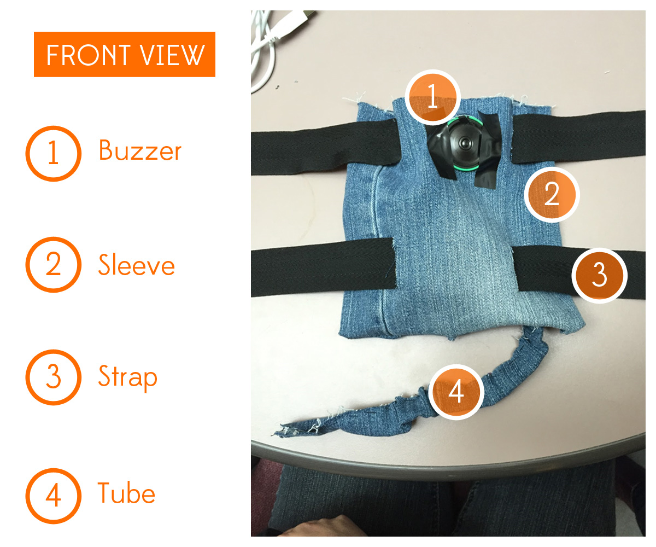
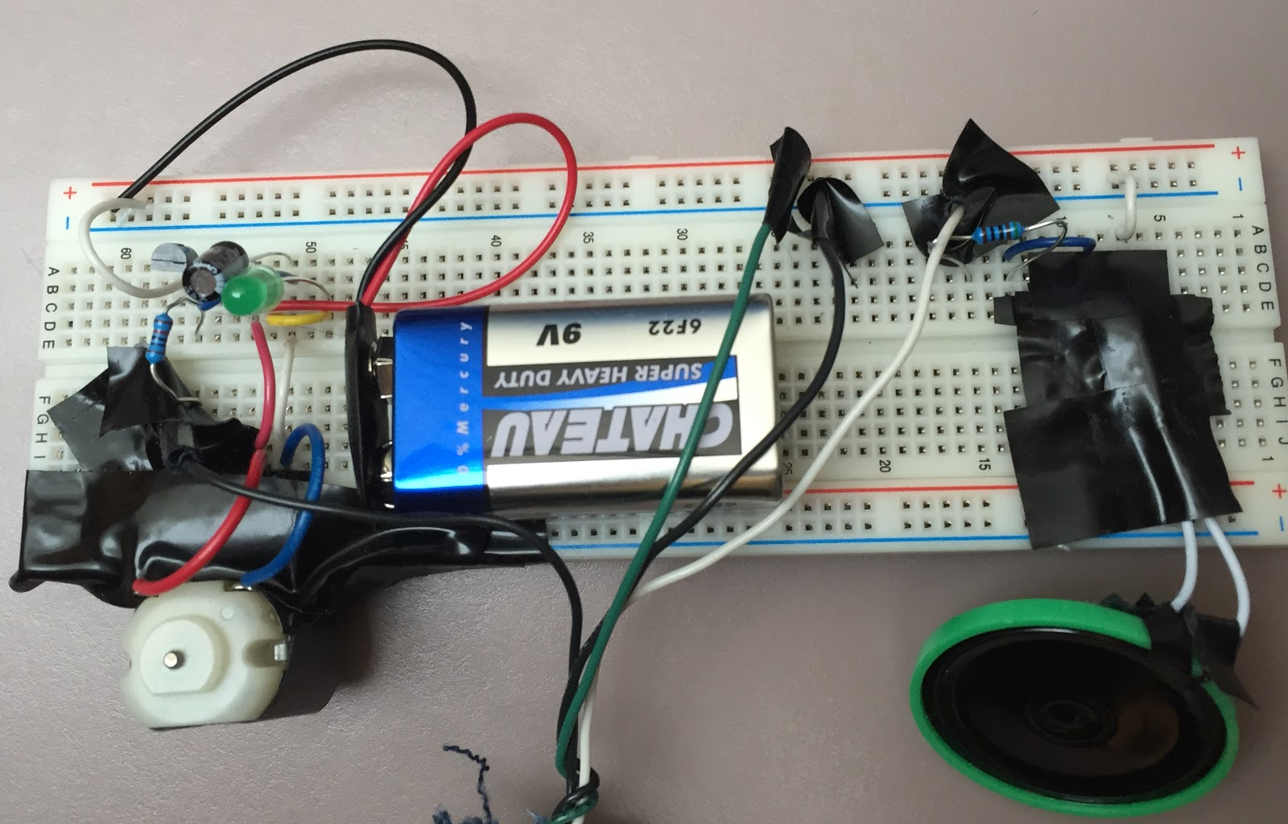
Design part I: Physical
Sleeve with adjustable straps
Positioning of circuit components
Fabric wire sheath

Slide 4
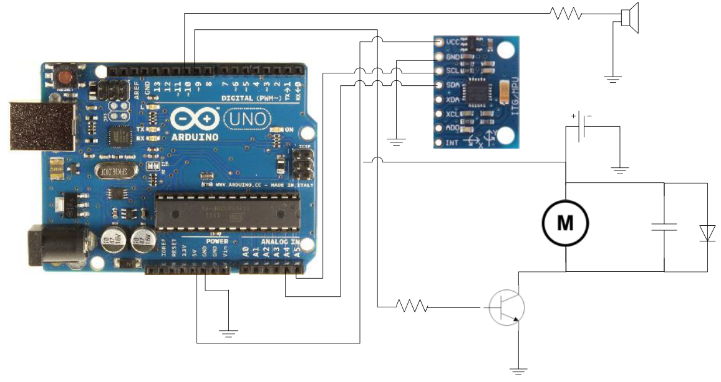

Slide 5
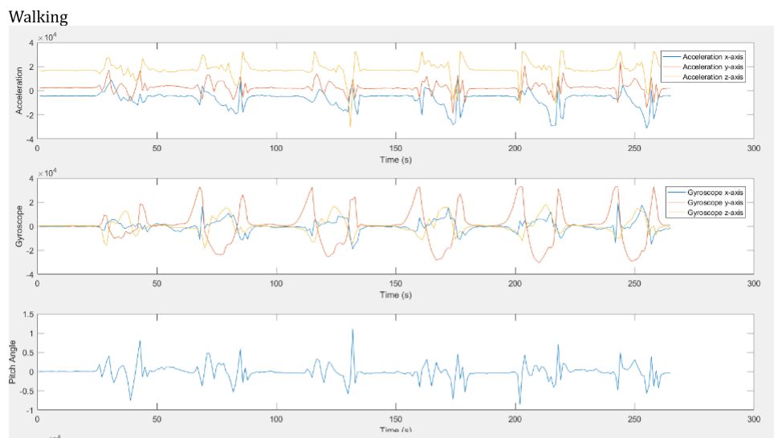
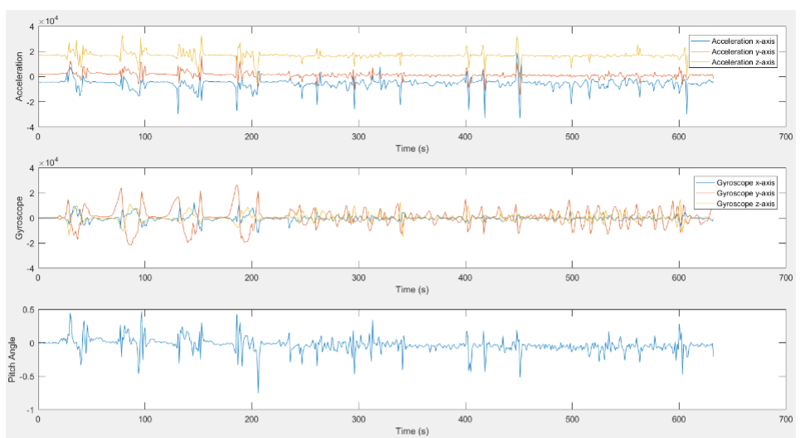
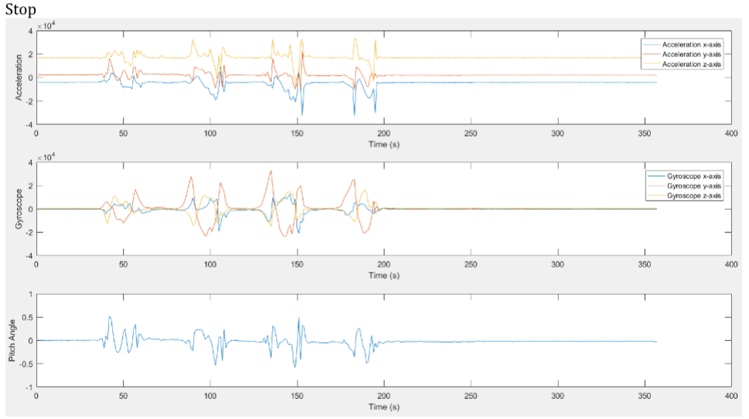
Design part II: Signal Processing
Walking
Freezing
Stopping
What signal did we look at? → Gyroscope Y
What features did we analyse? → Amplitude and Period
Could we have picked alternative signals? → Sure!

Slide 6
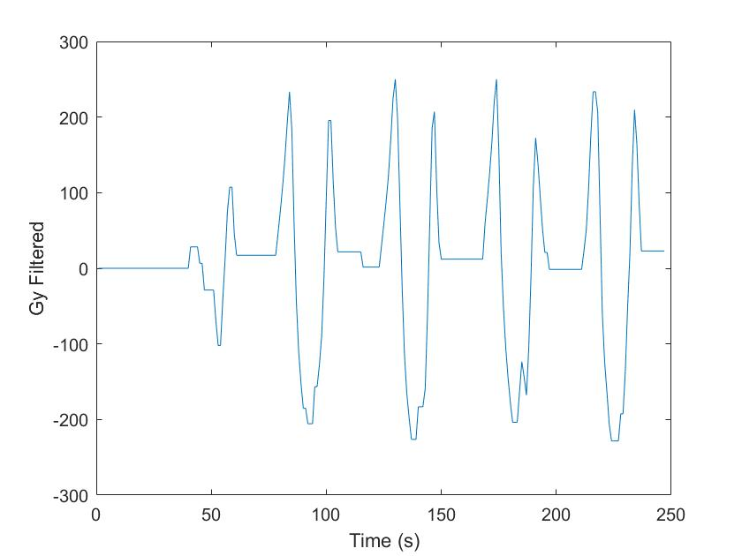
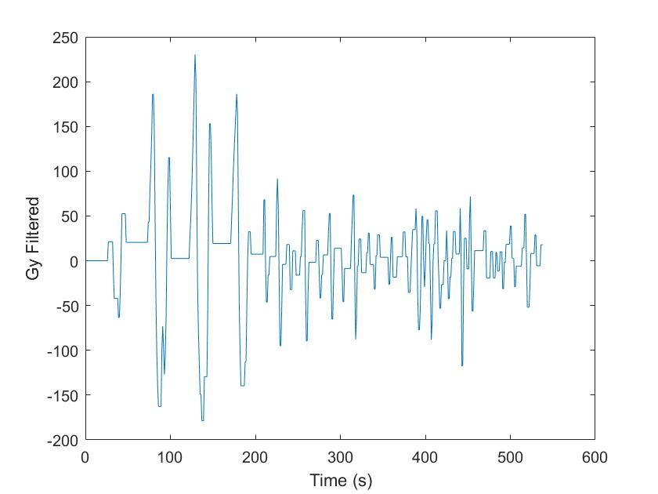
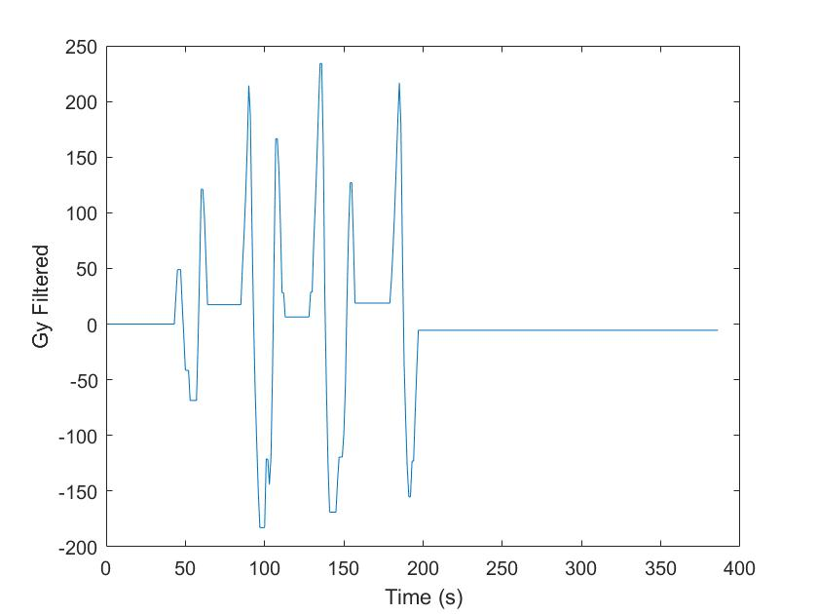
Design part II: Signal Processing
Walking
Freezing
Stopping
Filtering: get rid of noise…by making it all equal to 0
Pattern recognition: threshold for period & amplitude of 1 flux

Slide 7

How do we know it works?
Tested against multiple data sets
Walking (x10)
Freezing (x10)
Stopping (x10)
Dual feature analysis → amplitude & period

Slide 8
Demonstration
…it actually works!

Slide 9
Analysis
Algorithm
Consistent performance with testing participant
However, everyone walks differently
Hardcoded threshold values may fail for other patients
Snug & adjustable to different leg sizes
Does not perform as well over loose-fitting clothing (slips)
Physical design

Slide 10
Thank you!
questions?

Slide 11
References
Rohrseitz, N. (2016). Beyond Parkinson's: Medium Magazine. https://medium.com/the-future-beyond/beyond-parkinson-s-acdbe5c521fb#.n4rutt2jn

